Slide 1
Test Driven or Test Last
Andreas Jørgensen, Alex Langhoff

Slide 2
Abstract
Is Test Driven Development (TDD) better then Test Last Development(TLD)?
Choosing the wrong test strategi would be costly and could end up in projects that dont add value to your company.
Even if alot of sources says TDD is always the right choice, it really isnt.
There is no simple way to determine or meassure if one is better then the other, its is important for a development team to choose the right strategy for the project at hand.

Slide 3
How and why?

Slide 4
Hypothesis
The hypothesis is that TDD is the superior testing strategy compared to TLD.

Slide 5
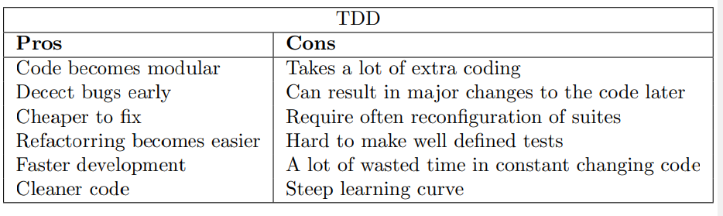
Why TDD

Slide 6
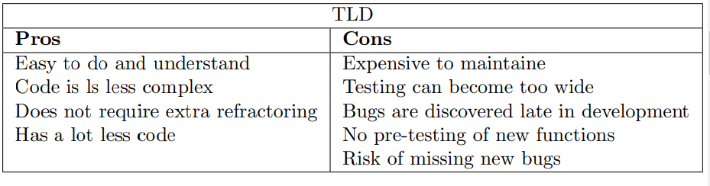
Why TLD

Slide 7
Conclusion.

